Slide 1

Algorithms & Data Structures
Week 7
Weighted graphs

Slide 2
Last week we discussed…
Graphs
  Adjacency list representation
  Traversal
    depth-first – using a (call) stack
    breadth-first – using a queue
  Topological sorting
    Pre & post ordering
B
D
F
A
E
C
G

Slide 3
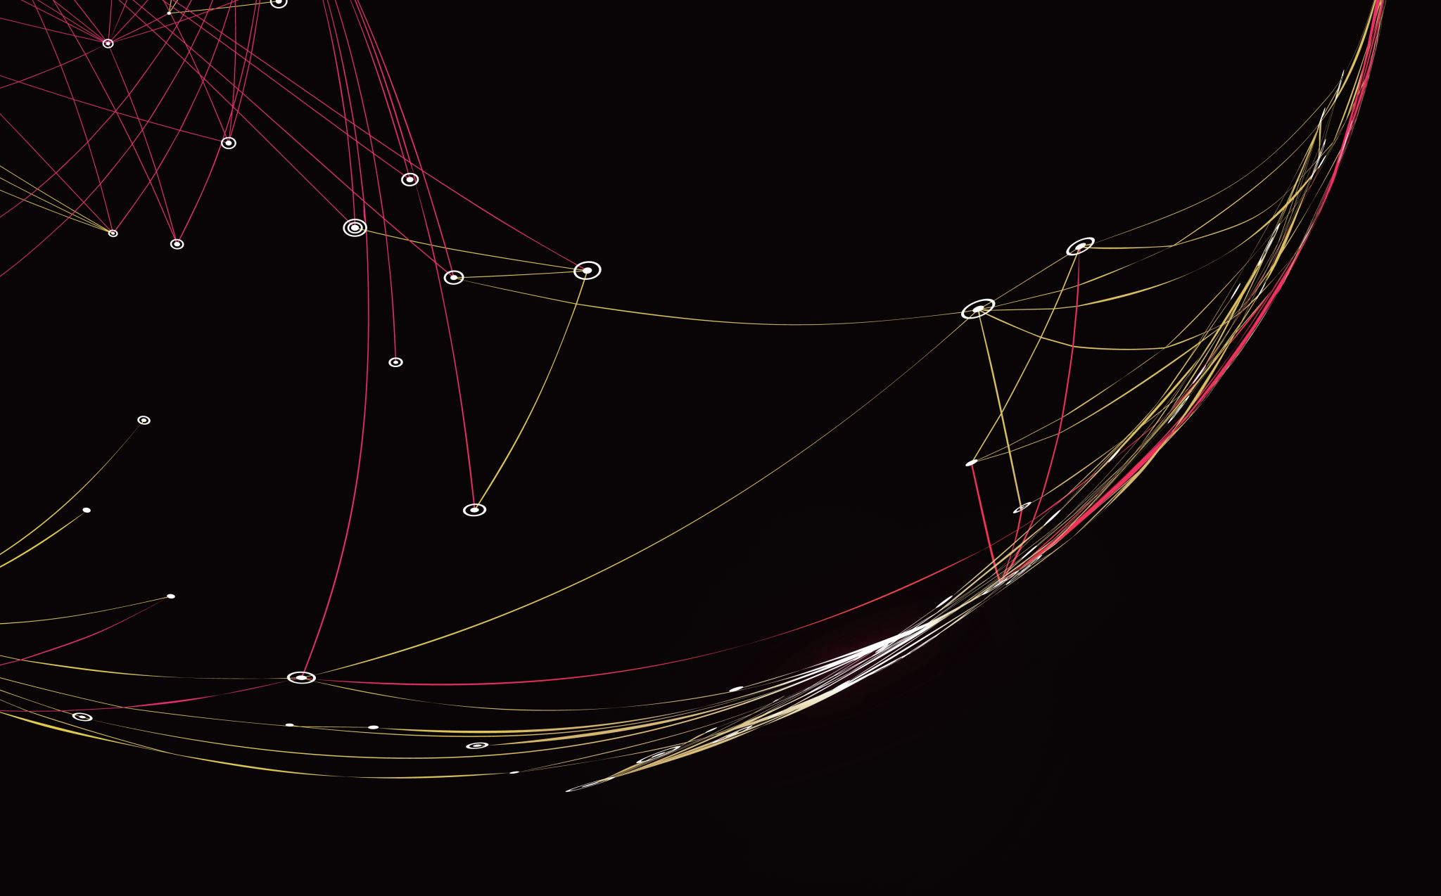
Graph algorithms
Minimizing costs & distances

Slide 4
This week:
3
17
Weighted graphs
  Shortest paths & topological sorting
  Dijkstra’s algorithm
  Minimum spanning trees
    Prim’s algorithm
    Kruskal’s algorithm
  The Disjoint-set data structure
B
D
F
1
A
10
-1
11
6
-2
E
C
42
7
G

Slide 5

Weighted graphs in real life
Weights can be:
Distances in maps for navigation
Costs: Flight ticket prices, Fuel cost, Travel time
Duration of tasks in project scheduling
Exchange rates in currency conversions
Many algorithms compute “optimal” ways of connecting nodes & edges
200
20
Enschede
Leiden
80
140
240
Den Haag
70
Utrecht
180
Maastricht
Cities connected by roads

Slide 6
Minimizing costs / distances
There may be many many paths between two nodes – which ones is the shortest?
Finding the shortest path between two nodes
  Navigation
Finding the shortest route connecting all nodes
  Cycle-free communication network
  STP protocol
  Travelling salesman problem
C
6
3
2
4
6
A
D
B
1
2
7
E

Slide 7
Shortest Paths
We already found a path to D of length 4!
Path ADB is 10
There are many paths between A and B – which one is the shortest?
Follow paths from A & update distances on the go
We might need to follow the same edge over and over again
How to prevent this?
  Keep track of (shortest) distances from A to ALL nodes
C
6
3
2
4
6
A
D
B
1
2
7
E
Path ACDB is 14

Slide 8

Shortest paths – directed acyclic graphs
7
6
5
9
12
14
11
If there are no cycles, then for every node we can identify its “upstream” nodes
Visit nodes in topological order!
Time complexity?
4
0
7
B
D
2
A
F
4
3
10
2
Upon visiting a node, we are certain that its current distance is the shortest
12
C
E
-1
1
G
$$O\left(m+n\right)$$
Topological order: A, C, G, E, B, D, F
2
1
2

Slide 9
Shortest path trees
Shortest paths form a tree
  Every node has one “parent”
  Path from root node is the shortest path
4
7
B
D
2
A
F
4
3
10
2
12
C
E
-1
1
G

Slide 10

Shortest path trees
Shortest paths form a tree
  Every node has one “parent”
  Path from root node is the shortest path
4
7
B
D
2
A
F
4
3
10
2
12
C
E
-1
1
G

Slide 11
Shortest path trees
Shortest paths form a tree
  Every node has one “parent”
  Path from root node is the shortest path
4
3
B
D
3
A
F
8
3
10
A
2
2
C
-1
2
G
C
E
1
This is the “shortest paths tree”
3
E
4
1
B
4
G
D
2
F

Slide 12
Shortest paths – undirected graphs
Shortest paths from A
  Explore all edges connected to A
Now choose a next node to explore from
  Does it make sense to explore from G?
    No, might be a waste of effort
  Does it make sense to explore from D?
    Yes, D can’t be closer to A than 21
    But only if there are no negative edge weights!
C
B
46
23
D
21
J
67
A
E
42
55
H
105
27
F
G
15

Slide 13








Shortest paths – Dijkstra’s algorithm
8
0
$$∞$$
$$∞$$
A
8
B
1
C
Set distance of start node to zero & others to “extremely far away”
While there are unvisited nodes:
  Find the one that has the smallest current distance
  Update the distance to its neighbours
2
4
5
2
$$∞$$
$$∞$$
$$∞$$
D
E
F
1
1
3
4
2
$$∞$$
$$∞$$
$$∞$$
G
H
J
1
3
Visited:
A

Slide 14
Shortest paths – Dijkstra’s algorithm
0
8
$$∞$$
A
8
B
1
C
Set distance of start node to zero & others to “extremely far away”
While there are unvisited nodes:
  Find the one that has the smallest current distance
  Update the distance to its neighbours
2
4
5
2
3
$$∞$$
$$∞$$
D
E
F
1
1
3
4
2
5
$$∞$$
$$∞$$
$$∞$$
G
H
J
1
3
Visited:
A
D

Slide 15
Shortest paths – Dijkstra’s algorithm
7
0
8
$$∞$$
A
8
B
1
C
Set distance of start node to zero & others to “extremely far away”
While there are unvisited nodes:
  Find the one that has the smallest current distance
  Update the distance to its neighbours
2
4
5
4
2
3
$$∞$$
D
E
F
1
1
3
4
2
5
7
$$∞$$
$$∞$$
G
H
J
1
3
Visited:
A
D
E

Slide 16
Shortest paths – Dijkstra’s algorithm
0
7
9
8
1
$$∞$$
A
B
C
Set distance of start node to zero & others to “extremely far away”
While there are unvisited nodes:
  Find the one that has the smallest current distance
  Update the distance to its neighbours
2
4
5
2
3
4
D
E
F
1
1
3
4
2
5
7
$$∞$$
6
G
H
J
1
3
Visited:
A
D
E
F

Slide 17
Shortest paths – Dijkstra’s algorithm
0
7
9
A
8
B
1
C
Set distance of start node to zero & others to “extremely far away”
While there are unvisited nodes:
  Find the one that has the smallest current distance
  Update the distance to its neighbours
2
4
5
2
3
4
D
E
F
1
1
3
4
2
5
6
7
6
G
H
J
1
3
Visited:
A
D
E
F
G

Slide 18
Shortest paths – Dijkstra’s algorithm
0
7
9
A
8
B
1
C
Set distance of start node to zero & others to “extremely far away”
While there are unvisited nodes:
  Find the one that has the smallest current distance
  Update the distance to its neighbours
2
4
5
2
3
4
D
E
F
1
1
3
4
2
5
6
6
G
H
J
1
3
Visited:
A
D
E
F
G
H

Slide 19
Shortest paths – Dijkstra’s algorithm
0
7
9
A
8
B
1
C
Set distance of start node to zero & others to “extremely far away”
While there are unvisited nodes:
  Find the one that has the smallest current distance
  Update the distance to its neighbours
2
4
5
2
3
4
D
E
F
1
1
3
4
2
5
6
6
G
H
J
1
3
Visited:
A
D
E
F
G
H
J

Slide 20
Shortest paths – Dijkstra’s algorithm
0
7
8
8
1
9
A
B
C
Set distance of start node to zero & others to “extremely far away”
While there are unvisited nodes:
  Find the one that has the smallest current distance
  Update the distance to its neighbours
2
4
5
2
3
4
D
E
F
1
1
3
4
2
5
6
6
G
H
J
1
3
Visited:
A
D
E
F
G
H
J
B

Slide 21
Shortest paths – Dijkstra’s algorithm
0
7
8
A
8
B
1
C
Set distance of start node to zero & others to “extremely far away”
While there are unvisited nodes:
  Find the one that has the smallest current distance
  Update the distance to its neighbours
2
4
5
2
3
4
D
E
F
1
1
3
4
2
NOTE: This only works in case all edge weights are at least zero!
5
6
6
G
H
J
1
3
Visited:
A
D
E
F
G
H
J
B
C

Slide 22












Dijkstra’s algorithm – time complexity
Assumption: use of hash table to store node distances
Main operations: find next node & update node distance
Finding the node that has the smallest distance:
Updating node distance
Worst case:
  Find next node to visit: n times
  Updating “current” distance: m times
Unsorted
Array
Binary
Search
Tree
Priority
Queue
$$O\left(n\right)$$
$$O\left(\log{n}\right)$$
$$O\left(\log{n}\right)$$
$$O\left(1\right)$$
$$O\left(\log{n}\right)$$
$$O\left(\log{n}\right)$$
$$O\left(n^{2}\right)$$
$$O\left(n\log{n}\right)$$
$$O\left(n\log{n}\right)$$
$$O\left(m\right)$$
$$O\left(m\log{n}\right)$$
$$O\left(m\log{n}\right)$$

Slide 23

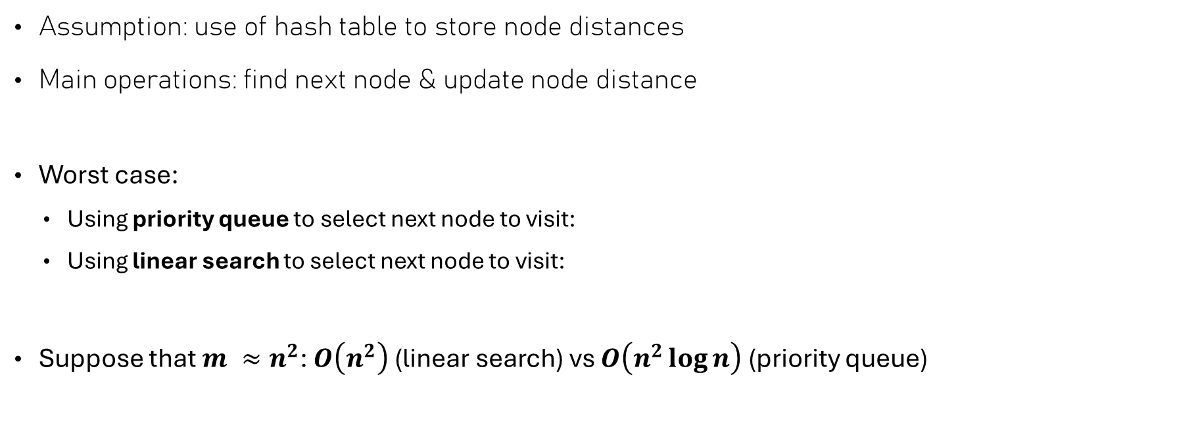

Dijkstra’s algorithm – time complexity
Assumption: use of hash table to store node distances
Main operations: find next node & update node distance
Worst case:
  Using priority queue to select next node to visit:
  Using linear search to select next node to visit:
Suppose that $m ≈n^{2}$: $O\left(n^{2}\right)$ (linear search) vs $O\left(n^{2}\log{n}\right)$ (priority queue)
$$O\left((m+n)\log{n}\right)$$
$$O\left(m+n^{2}\right)$$

Slide 24

Spanning Trees
Minimizing the cost of connectedness

Slide 25
The spanning tree problem
The shortest paths tree gives the shortest path from one node to all other ones
  Minimizes the travelling costs from a single starting point
How do you choose to connect all nodes so that:
  There’s a single (unique) path between any two nodes
  It has the smallest edge weight sum
Or: what is the “minimum spanning tree” (MST)?
4
3
B
D
3
A
F
8
3
10
2
2
C
E
4
1
Total cost: 14
G

Slide 26
The minimum spanning tree problem
Given an undirected weighted graph
  What is the optimal way to connect all nodes without having cycles?
Two approaches
  Add edges in order of increasing costs, one by one until a cycle is introduced (Kruskal’s)
  Add nodes in order of increasing connection costs until all nodes are added (Prim’s)
4
3
B
D
3
A
F
8
3
10
2
2
C
E
4
1
Total cost: 14
G

Slide 27
Prim’s algorithm
10
9
5
2
Pseudocode:
  Start with an arbitrary node & add it to the result
  While there are nodes that are not part of the result:
    Find the cheapest edge between a node that is in result and one that is not
    Add the edge & node to the result
3
8
7
6
9
2
5
3
4
1
2

Slide 28
Prim’s algorithm
10
9
5
Pseudocode:
  Start with an arbitrary node & add it to the result
  While there are nodes that are not part of the result:
    Find the cheapest edge between a node that is in result and one that is not
    Add the edge & node to the result
3
8
7
6
9
2
5
3
4
1
2

Slide 29
Prim’s algorithm
10
9
5
Pseudocode:
  Start with an arbitrary node & add it to the result
  While there are nodes that are not part of the result:
    Find the cheapest edge between a node that is in result and one that is not
    Add the edge & node to the result
3
8
7
6
9
2
5
4
1
2

Slide 30
Prim’s algorithm
10
9
5
Pseudocode:
  Start with an arbitrary node & add it to the result
  While there are nodes that are not part of the result:
    Find the cheapest edge between a node that is in result and one that is not
    Add the edge & node to the result
3
8
7
6
9
2
5
4
2

Slide 31
Prim’s algorithm
10
9
5
Pseudocode:
  Start with an arbitrary node & add it to the result
  While there are nodes that are not part of the result:
    Find the cheapest edge between a node that is in result and one that is not
    Add the edge & node to the result
3
8
7
6
9
2
5
4

Slide 32
Prim’s algorithm
10
9
5
Pseudocode:
  Start with an arbitrary node & add it to the result
  While there are nodes that are not part of the result:
    Find the cheapest edge between a node that is in result and one that is not
    Add the edge & node to the result
3
8
7
6
9
5
4

Slide 33
Prim’s algorithm
10
9
5
Pseudocode:
  Start with an arbitrary node & add it to the result
  While there are nodes that are not part of the result:
    Find the cheapest edge between a node that is in result and one that is not
    Add the edge & node to the result
3
8
7
6
9
5

Slide 34
Prim’s algorithm
10
9
Pseudocode:
  Start with an arbitrary node & add it to the result
  While there are nodes that are not part of the result:
    Find the cheapest edge between a node that is in result and one that is not
    Add the edge & node to the result
8
9

Slide 35
Prim’s algorithm
10
9
5
2
Pseudocode:
  Start with an arbitrary node & add it to the result
  While there are nodes that are not part of the result:
    Find the cheapest edge between a node that is in result and one that is not
    Add the edge & node to the result
3
8
7
6
9
2
5
3
4
1
2
Total costs: 25

Slide 36
Prim’s algorithm – why it works
10
9
5
2
After the first edge is added, that one edge forms an MST of the blue nodes
Adding the cheapest edge gives the MST that consists of the blue nodes plus the newly connected node
3
8
7
6
9
2
5
3
4
1
2
Total costs: 25

Slide 37
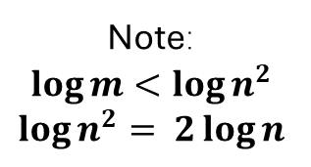
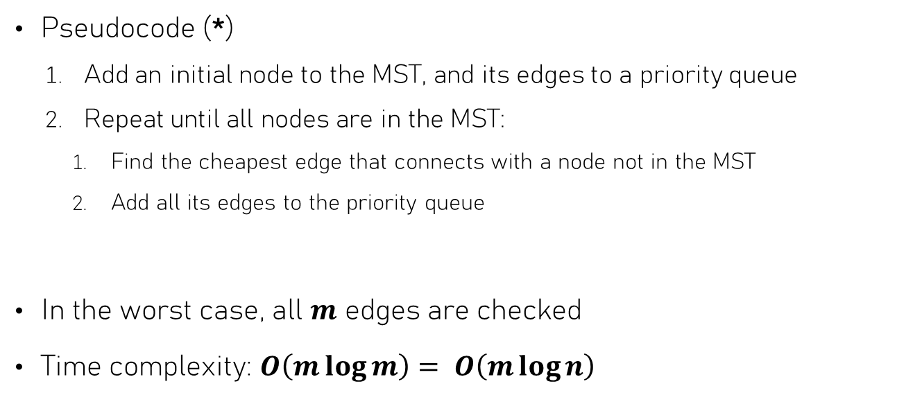
Prim – Implementation & time complexity
Pseudocode (*)
  Add an initial node to the MST, and its edges to a priority queue
  Repeat until all nodes are in the MST:
    Find the cheapest edge that connects with a node not in the MST
    Add all its edges to the priority queue
In the worst case, all $m$ edges are checked
Time complexity: $O\left(m\log{m}\right)= O\left(m\log{n}\right)$
Assumes a hash table is used for membership testing
O(log m)
O(log m)
O(log m)
Note:
$$\log{m}<\log{n^{2}}$$
$$\log{n^{2}}= 2\log{n}$$
O(m log m)
(*) This is a simplified version of the algorithm but it has the same time complexity

Slide 38
Kruskal’s algorithm
10
9
5
2
Pseudocode:
  Start with a result that has all nodes but no edges
  While we have not yet added n – 1 edges:
    Find the cheapest edge
    Add it to the graph, but only if it does not introduce a cycle (if it does, exclude it)
3
8
7
6
9
2
5
3
4
1
2

Slide 39
Kruskal’s algorithm
10
9
5
2
Pseudocode:
  Start with a result that has all nodes but no edges
  While we have not yet added n – 1 edges:
    Find the cheapest edge
    Add it to the graph, but only if it does not introduce a cycle (if it does, exclude it)
3
8
7
6
9
2
5
3
4
1
2

Slide 40
Kruskal’s algorithm
10
9
5
2
Pseudocode:
  Start with a result that has all nodes but no edges
  While we have not yet added n – 1 edges:
    Find the cheapest edge
    Add it to the graph, but only if it does not introduce a cycle (if it does, exclude it)
3
8
7
6
9
2
5
3
4
1
2

Slide 41
Kruskal’s algorithm
10
9
5
2
Pseudocode:
  Start with a result that has all nodes but no edges
  While we have not yet added n – 1 edges:
    Find the cheapest edge
    Add it to the graph, but only if it does not introduce a cycle (if it does, exclude it)
3
8
7
6
9
2
5
3
4
1
2

Slide 42
Kruskal’s algorithm
10
9
5
2
Pseudocode:
  Start with a result that has all nodes but no edges
  While we have not yet added n – 1 edges:
    Find the cheapest edge
    Add it to the graph, but only if it does not introduce a cycle (if it does, exclude it)
3
8
7
6
9
2
5
3
4
1
2

Slide 43
Kruskal’s algorithm
10
9
5
2
Pseudocode:
  Start with a result that has all nodes but no edges
  While we have not yet added n – 1 edges:
    Find the cheapest edge
    Add it to the graph, but only if it does not introduce a cycle (if it does, exclude it)
3
8
7
6
9
2
5
3
4
1
2
Total costs: 25

Slide 44
Kruskal’s algorithm – why it works
10
9
5
2
We build up several MSTs in “parallel”
  Also called a forest
When joining two trees into a new tree, it is the “cheapest” way of doing so
Every newly formed tree is thus a minimum spanning tree, so the last formed tree must be a minimum spanning tree as well
3
8
7
6
9
2
5
3
4
1
2
Total costs: 25

Slide 45

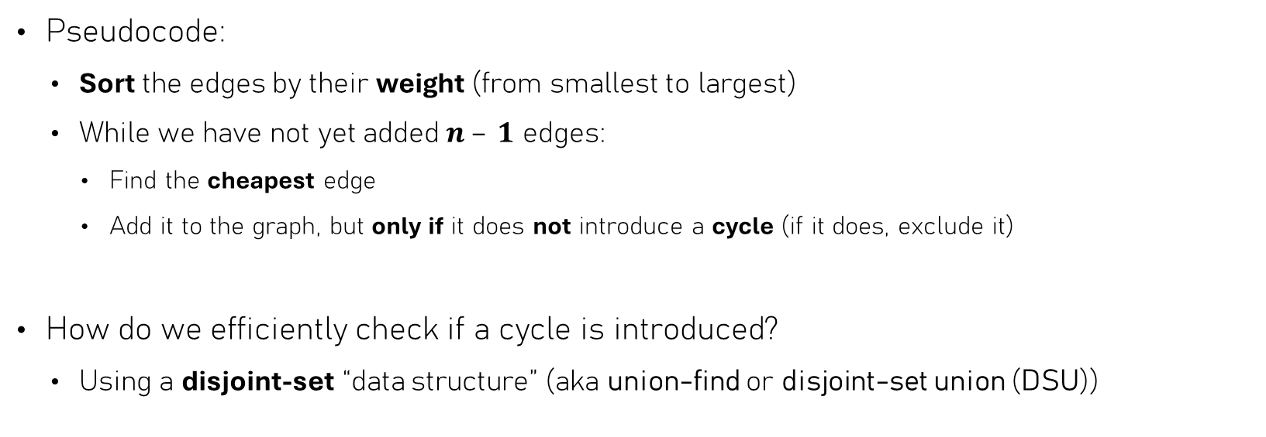


Kruskal – Implementation & time complexity
Pseudocode:
  Sort the edges by their weight (from smallest to largest)
  While we have not yet added $n – 1$ edges:
    Find the cheapest edge
    Add it to the graph, but only if it does not introduce a cycle (if it does, exclude it)
How do we efficiently check if a cycle is introduced?
  Using a disjoint-set “data structure” (aka union-find or disjoint-set union (DSU))
$$O\left(m\log{m}\right)$$
$$O\left(1\right)$$
$$O\left(?\right)$$

Slide 46

Keeping track of connectedness
Representative: the node v for which parent[v] = v
What’s the representative of A?
Connected nodes are in the same set
Connecting a node makes it a member of that set
Keep track of the “representative” of the set
When a node a connects to node b, then:
  parent[a] = parent[b]
To check if nodes a and b belong to the same set:
  representative(a) == representative(b)?
A
parent: A
parent: B
B
parent: B
parent: C
C
parent: C
parent: D
D
parent: D
def representative(v):
return v if parent[v] == v
else representative(parent[v])
Worst case time complexity: $O\left(n\right)$

Slide 47
Optimizations → Disjoint-Set DS
What’s the representative of A?
Update parents while finding representative!
When a node a connects to node b, then:
  parent[representative(a)] = representative(b)
Extra: Prevent long chains by making the smallest set’s be the “child” of the largest set’s representative (advanced)
A
parent: B
parent: D
This is called path compression
def representative(v):
if parent[v] != v:
parent[v] = representative(parent[v])
return parent[v]
B
parent: C
parent: D
C
parent: D
parent: D
D
parent: D

Slide 48
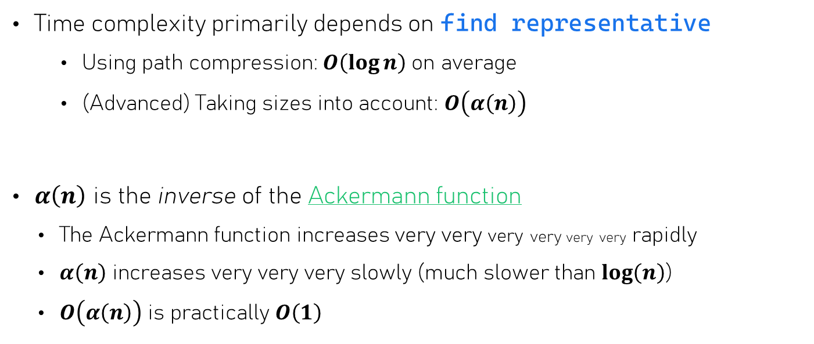
Disjoint-Set – time complexity
Time complexity primarily depends on find representative
    Using path compression: $O\left(\log{n}\right)$ on average
    (Advanced) Taking sizes into account: $O\left(α\left(n\right)\right)$
$α\left(n\right)$ is the inverse of the Ackermann function
  The Ackermann function increases very very very very very very rapidly
  $α\left(n\right)$ increases very very very slowly (much slower than $\log\left(n\right)$)
  $O\left(α\left(n\right)\right)$ is practically $O\left(1\right)$
Out of scope

Slide 49
Summary – graph algorithms
Both algorithms visit every node just once!
Shortest paths
  Directed acyclic graphs: topological ordering
  Non-negative edge weights: Dijkstra’s algorithm
Minimum spanning trees
  Prim’s algorithm – adding one node at a time, uses priority queue and a set
  Kruskal’s algorithm – adding one edge at a time, uses a disjoint-set (aka union-find / merge-union) data structure

